Slide 1
Programming Fundamentals
By
Shazmeen Batool

Slide 2
Previous Lecture
do-while loop

Slide 3
Today’s Lecture
Nested loop
Break
Continue

Slide 4
Nested Loop
A loop that is inside another loop is called a nested loop.
A loop can be nested inside another loop.
Nested loops consist of an outer loop and one or more inner loops.
Each time the outer loop is repeated, the inner loops are reentered, and started anew

Slide 5
Nested Loop
A clock is a good example of something that works like a nested loop. The second hand, minute hand, and hour hand all spin around the face of the clock.
Each time the hour hand increments, the minute hand increments 60 times. Each time the minute hand increments, the second hand increments 60 times.
The program in the next slide will count through each second of 24 hours.

Slide 6
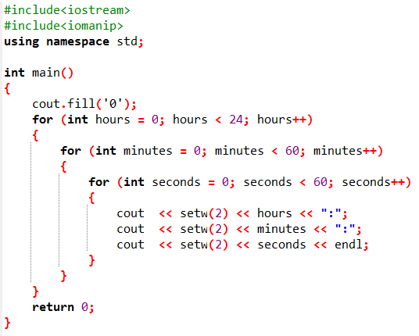
Example
The program will count through each second of 24 hours.

Slide 7
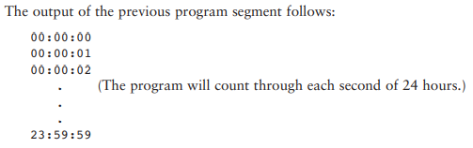
Nested Loop

Slide 8
cout.fill('0');
The fill member function of cout changes the fill character, which is a space by default. In the program segment above, the fill function causes a zero to be printed in front of all single digit numbers.
Sets the "filler" character to '0'. So, if a number is short, it adds zeros in front (e.g., 1 becomes 01).

Slide 9
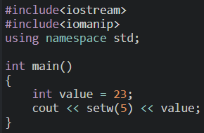

setw()
cout offers a way of specifying the minimum number of spaces to use for each number. A stream manipulator, setw, can be used to establish print fields of a specified width.
A new header file, iomanip, is included. It must be used in any program that uses setw.

Slide 10
setw()
Notice that the number occupies the last two positions in the field. Since the number did not use the entire field, cout filled the extra 3 positions with blank spaces. Because the number appears on the right side of the field with blank spaces “padding” it in front, it is said to be right-justified.

Slide 11
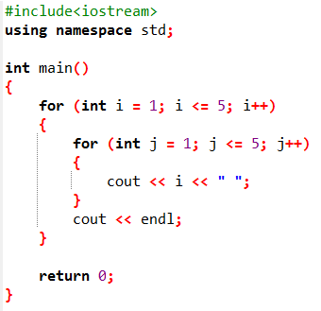
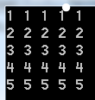
Nested Loop Example
Output:

Slide 12
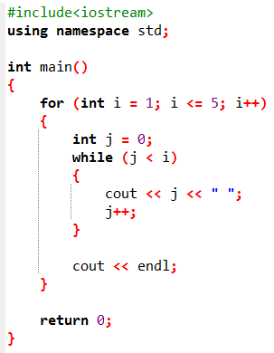
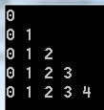
Show the output of the following program.
Output:

Slide 13
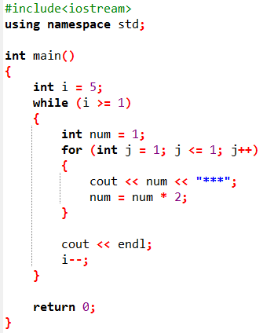

Show the output of the following program.
Output:

Slide 14

Task
Write a program to print pyramid star pattern series

Slide 15
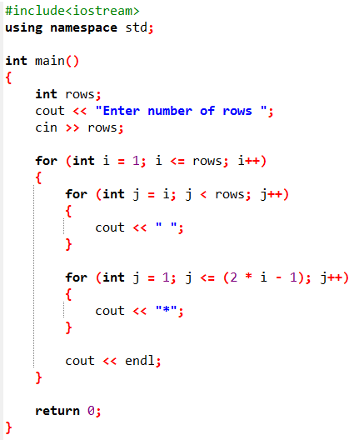
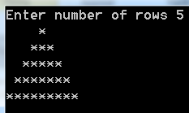
Output:

Slide 16
break Statement
The break statement can be used to jump out of a loop.
You have used the keyword break in a switch statement.
You can also use break in a loop to immediately terminate the loop.

Slide 17
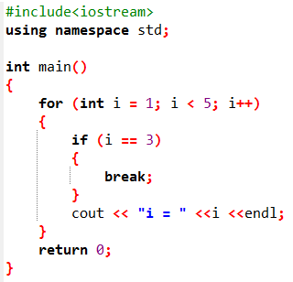

Example
Output:

Slide 18
continue Statement
The continue statement breaks one iteration (in the loop), if a specified condition occurs, and continues with the next iteration in the loop.

Slide 19
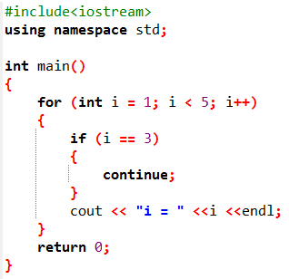

Example
Output:

Slide 20
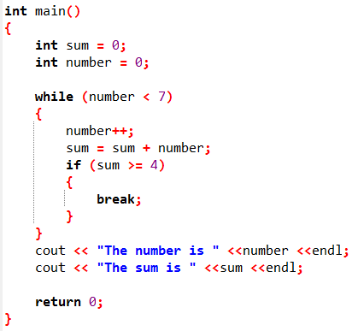

Show the output of the following program.
Output:

Slide 21
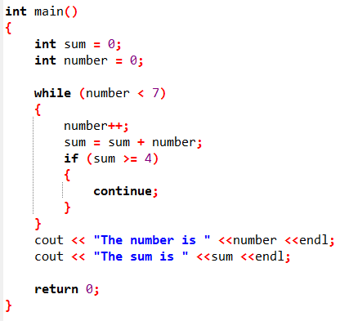

Show the output of the following program.
Output:

Slide 22
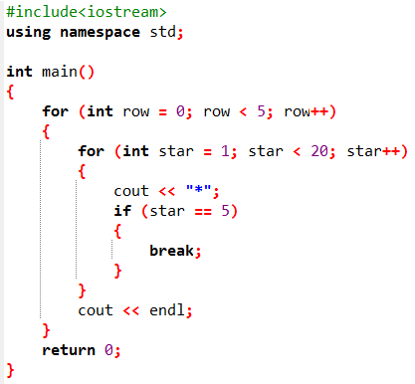

Using break in Nested Loop
Output:

Slide 23
Next Lecture
Array

